Slide 2
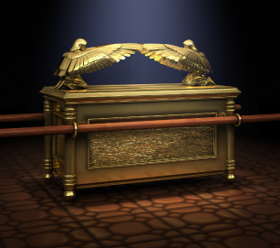
Christ in the ark of the covenant
Exodus 25:10-16

Slide 3
The ark typified the dignity & purity of Christ's character
Made of incorruptible material – Psalm 16:10
Was overlaid with gold – Exodus 25
The Divine Nature of Christ
  Embodiment of Deity – Colossians 2:9 “fullness of the Godhead bodily”
Had a crown of gold – King Of Kings and Lord of Lords (Revelation 17:14)
Lamb of God – John 1:29
“Perfection and completeness of Christ’s character.”

Slide 4
Contents typified fulness & work of christ
Contained two tables of stone upon which God had written the Law in His own hand!
John 1:17 “law was given through Moses…”
Just as the law came through Moses, GRACE & TRUTH have come through Christ
Ephesians 4:21 “truth is IN CHRIST’
1 Corinthians 9:21 “under law to Christ”
James 1:25 “perfect law of liberty”
Hebrews Chapter 8 – Second law; First was taken away

Slide 5
Contents typified fulness & work of christ
The golden pot of manna – omer full preserved
John 6:35 “I am the bread of life…”
John 6:41-45 “everyone who has heard and leaned from the Father comes to me.”
John 6:48-50 “Your fathers ate the manna in the wilderness and are dead.”
Aaron’s rod which budded
Christ is OUR High Priest – Hebrews 6:19,20; Zechariah 6:13; 1 Corinthians 15:24-26

Slide 6
The achievements of the ark
Parting of the waters of Jordan – Joshua 3:13
Christ opened a way for us from the GRAVE to HEAVENLY CANAAN! John 14:1-3
Revelation 1:17,18 “I have the keys of Hades and of Death.”
He conquered every obstacle that might hinder US from entering heaven!
Key roll in the Destruction of Jericho – Joshua Chapter 6
Jesus destroyed powers that would keep us from serving God – Romans 8:37-39

Slide 7
When Israel of old continued in sin & ignored the wishes of god
HE BROUGHT ABOUT THEIR ULTIMATE DESTRUCTION AS A NATION!
587 B.C. Babylonians defeated Israel and the Ark was lost forever!
70 A.D. Roman army under Titus destroyed Jerusalem and every vestige of God’s national Israel was lost!
IF we continue in SIN, ignoring the commandment of God given through His blessed SON, God will have nothing o do with us!

